Slide 1
Presentation brief for MCT’s
Title of presentation | Analyze and Optimize Data Warehouse Storage
Presentation\Lab length | Presentation: 10 - 20 minutes Lab: 50 – 60 minutes
Audience | Data Engineers, Data Scientists, Data Professionals, Data Architects, BI Professionals, Developers
Purpose | Understand skewed data and space usage Understand column store storage details Understand the impact of wrong choices for column data types Describe the impact of materialized views Understand rules for minimally logged operations
(think) Student key takeaways | The student should understand storage optimization concepts for a Data Warehousing solution The student should be familiar about analyses to perform in order to optimize Data Warehouse Storage The student should understand the impact of optimization of Data Warehouse Storage
(feel) Student desired mindset | The student may feel confusion about the different areas of optimization of Data Warehouse storage The student may feel confusion about identifying the course of action to optimize Data Warehouse Storage The student may feel they are not familiar with skewed data, minimally logged operations or column data types
(do) Student outcomes | The student should be able to articulate a one sentence description of Data Warehouse Storage optimization techniques. The student should be able to analyze for skewed data and space usage The students should be able to work with column storage details, column data types, materialized views and minimally logged operations
More information | For MCT course feedback, visit the Microsoft Official Courseware forum
Notes:
Instructor notes and guidance
This slide is for MCT use only, outlining the aims and objectives of this module.

Slide 2
DP-203T00: Analyze and Optimize Data Warehouse Storage
Notes:
Instructor notes and guidance
Introduce to the students that this module explores the range of analyses and optimization techniques for Data Warehouse Storage. At this stage they are being introduced to the different options to look into when wanting to optimize Data Warehouse Storage.
In the lab, the students will learn how to analyze and optimize the data storage of the Azure Synapse dedicated SQL pool. They will learn the techniques to understand table space usage and column store storage details. Next, they will learn how to compare storage requirements between identical tables that use different data types. Finally, they will observe the impact that materialized views have when executed in place of complex queries and learn how to avoid extensive logging by optimizing delete operations.
That this is an example of a module where the students learn more by doing the lab, rather than reading the slides or student manual

Slide 3

Agenda
Lesson 01 – Understand skewed data and space usage
Lesson 02 – Understand column store storage details and impact of column data types
Lesson 03 – Describe the impact of materialized views
Lesson 04 – Understand rules for minimally logged operations
Notes:
Instructor notes and guidance
This space has been left deliberately blank.

Slide 4
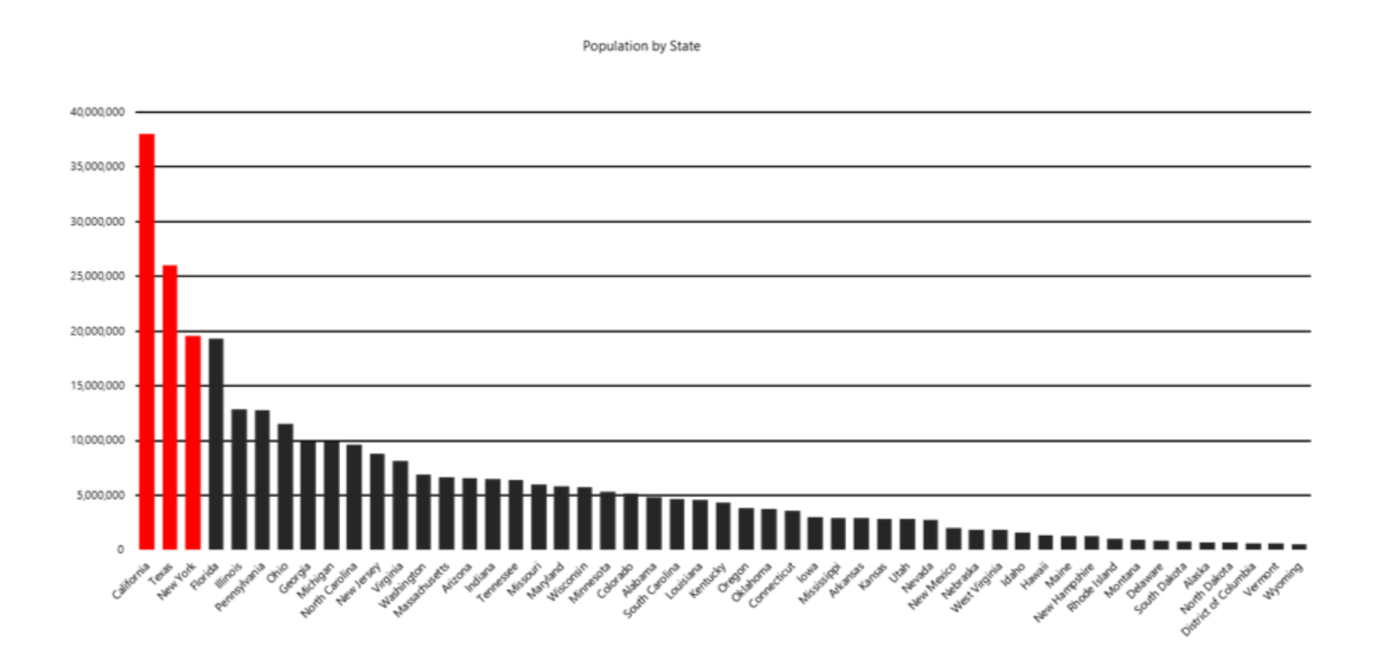
Understand skewed data and space usage
Notes:
Talking points
In order to optimize Data Warehouse Storage, an aspect to look at is for skewed data. Whether your data is skewed, can be determined and measured by using the mean, median and mode, to check for the center of a dataset.
How the mean, median and mode relate to each other, will give an insight of skewness of your dataset. A normal distribution of data, can be seen where the graph would be symmetric and looks like a bell curve, i.e. where the left and the right side of the curve are mirrors of each other.
There are two forms of skewed data:
Skewed data to the left
Skewed data to the right
In the slide you find that the data is unevenly distributed, i.e. one vertex gets much more data than its peers, a condition that makes the vertex work more than the others and that eventually slows down an entire job.
Therefore, it’s imperative to understand skewed data and its space usage.
A quick way to check for data skew is to use DBCC PDW_SHOWSPACEUSED. In order to have a reliable and balanced performance, the rows in your distributed table should be spread evenly across all the distributions.
In order to monitor the table data space usage and observe its relationship with different table distribution types as found using the DBCC PDW_SHOWSPACEUSED function. It is helpful to know the number of rows and the storage space used for indexing, for which you can use several System Dynamic Management Views (DMVs) in order to retrieve that information.
Instructor notes and guidance
Only explain skewed data and space usage in relation to optimization of Data Warehouse Storage, on this slide. Tell the students that coverage of column storage and column data types, materialized views and minimally logged operations will follow in the upcoming slides. Call out to the students, that in the lab for this module, they will experience different DMVs and code snippets, to check for skewed data and space usage themselves.
Recommended reading for this slide
Understand skewed data and space usage - Learn | Microsoft Docs

Slide 5
Understand column store storage details and impact of column data types
Maximize number of rows in rowgroup:
Enhancement of query performance
Use DMVs
Utilize sys.dm_pdw_nodes_db_column_store_row_group_physical_stats for column storage information
Use the smallest data type that works for your data
Minimizing the size of data types shortens the row length, which leads to better query performance
Notes:
Talking points
Column Storage Details:
A rowgroup is a collection of rows that shares the same features in the data. Therefore, if you have a column of data that contains US states. A potential rowgroup example could include that all data beginning in the same state, belongs to the same rowgroup ( an example of this is CA, WA etc). Since a columnstore index improves performance if a rowgroup has over 100.000 rows and scans a table by scanning column segments of individual rowgroups, maximizing the number of rows in each rowgroup enhances query performance. If a rowgroup has a high number of rows, it improves data compression and therefore uses less IO to read from disk. It is imperative for enhanced query performance, to maximize the numbers of rows per rowgroup in a columnstore index, since the number of rows in a rowgroup determines the rowgroup's quality. Columnstore indexes achieve good performance when rowgroups have at least 100,000 rows of data that has the same feature.
There are situations where there is not always enough memory available to compress all the rows for each rowgroup due to a bulk load or a columnstore index. When there is pressure on the memory, columnstore indexes trim the rowgroup sizes such that the compression in the columnstore can succeed. The DMV sys.dm_pdw_nodes_db_column_store_row_group_physical_stats exposes useful information such as number of rows in rowgroups and the reason for trimming, if there was trimming.
Column Data types:
Use the smallest data type that works for your data since minimizing the size of data types shortens the row length, which leads to better query performance.
Some tips:
Avoid defining character columns with a large default length.
Avoid using NVARCHAR when you only need VARCHAR
Use DATETIME instead of storing data values in different formats
Instructor notes and guidance
Only focus on the 3 talking points related to column storage details and the impact of column data types as shown in the slide. In the following slides, impact of materialized views, and minimally logged operations will be discussed in order to optimize Data Warehouse Storage.
Recommended reading for this slide
Understand column store storage details - Learn | Microsoft Docs
Understand the impact of wrong choices for column data types - Learn | Microsoft Docs

Slide 6
Describe the impact of materialized views
Reduce the execution time
Improve query execution plans
Low maintenance
High Availability and Resiliency
Notes:
Talking points
A materialized view pre-computes, stores, and maintains its data in SQL pool just like a table. There's no precomputation needed each time when a materialized view is used. That's why queries that use all or a subset of the data in materialized views can get faster performance. Even better, queries can use a materialized view without directly referencing it, so there's no need to change the application code.
An adequately designed materialized view provides the following benefits:
Reduce the execution time: The more complex the query, the higher the potential for execution-time saving. The most benefit is gained when a query's computation cost is high, and the resulting data set is small.
Improve query execution plans: The optimizer in the SQL pool can automatically use deployed materialized views
Low maintenance: All incremental data changes from the base tables are automatically added to the materialized views synchronously. This design allows querying materialized views to return the same data as directly querying the base tables.
High Availability and Resiliency: Data in materialized views gets the same high availability and resiliency benefits as data in regular tables
Instructor notes and guidance
Only focus on the 4 talking points of the impact of materialized views as one of the areas to look into for optimizing Data Warehouse Storage.
Recommended reading for this slide
Describe the impact of materialized views - Learn | Microsoft Docs

Slide 7
Understand rules for minimally logged operations
Roll back efficiency
Less tracking in transaction log
I/O Efficient
Notes:
Talking points
The difference between minimally logged operations and fully logged operations is that minimally logged operations are only tracking extended allocations and meta-data changes. It involves logging only the required information to roll back the transaction after a failure or for an explicit request (ROLLBACK TRAN). Therefore, much less information is tracked in the transaction log, which results in the idea that a minimally logged operation performs better than a similarly sized fully logged operation. Furthermore, because fewer writes go the transaction log, a much smaller amount of log data is generated, and so is more I/O efficient.
Some examples of operations that are capable of being minimally logged are:
CREATE TABLE AS SELECT (CTAS)
INSERT..SELECT
CREATE INDEX
ALTER INDEX REBUILD
Instructor notes and guidance
Call out the specific statements that are minimally logged:
CREATE TABLE AS SELECT (CTAS)
INSERT..SELECT
CREATE INDEX
ALTER INDEX REBUILD
Explain how these statements can improve the performance as listed in the talking points of this slide.
Recommended reading for this slide
Understand rules for minimally logged operations - Learn | Microsoft Docs

Slide 8
Review questions
Q01 – What would be the best approach to investigate if the data at hand is unevenly allocated across all distributions?
A01 – Using DBCC PDW_SHOWSPACEUSED to see the number of table rows that are stored in each of the 60 distributions.
Q02 – To achieve improved query performance, which one would be the best data type for storing data that contains less than 128 characters?
A02 – VARCHAR(128)
Q03 – What is a benefit of materialized views?
A03 – Reducing the execution time for complex queries with JOINs and aggregate functions.
Notes:
Instructor notes and guidance
This space has been left deliberately blank

Slide 9
Lab: Analyze and Optimize Data Warehouse Storage
Notes:
Instructor notes and guidance
This space has been left deliberately blank

Slide 10
Lab overview
This lab teaches you how to analyze and optimize the data storage of the Azure Synapse dedicated SQL pools. You will know techniques to understand table space usage and column store storage details. Next, you will know how to compare storage requirements between identical tables that use different data types. Finally, you will observe the impact materialized views have when executed in place of complex queries and learn how to avoid extensive logging by optimizing delete operations.
Lab objectives
After completing this lab, you will be able to:
Check for skewed data and space usage
Understand column store storage details
Study the impact of materialized views
Explore rules for minimally logged operations
Notes:
Instructor notes and guidance
In the lab students will be taught how to analyze and optimize the data storage of the Azure Synapse dedicated SQL pools. They will know techniques to understand table space usage and column store storage details. Next, they will know how to compare storage requirements between identical tables that use different data types. Finally, they will observe the impact materialized views have when executed in place of complex queries and learn how to avoid extensive logging by optimizing delete operations.
In exercise 1, you will analyze space used by tables and use a more advanced approach to understand the table space usage. This is an important technique for checking skewed data.
In exercise 2, you will understand column store storage by creating a view for a column store row group, then you will gather statistics and explore the columnstore details to establish if it will be performant.
In exercise 3, the student will create and populate tables with optimal column data types and look at tables with sub-optimal column data types, to compare storage requirements, in order to study the impact of wrong choices for column data types.
In exercise 4, here students will study the impact of materialized views, they will analyze the execution plan of a query and improve the execution plan of the query by creating a materialized view.
In exercise 5, the student explores rules for minimally logged operations and optimize a delete operation.

Slide 11











Lab 11 Overview
asacosmosdb<unique_suffix>
CosmosDB
Campaign Info
Azure Databricks
asagadatalake<unique_suffix>
Cluster
Azure Data Lake
wwi-02
Products (parquet)
dp203sql<unique_suffix>
SourceDB
Azure Synapse Analytics
Dedicated SQL Pool (SQLPool1)
Built-In Serverless SQL Pool
Apache Spark pool
Pipelines and Dataflows
Power BI
asagaworkspace<unique_suffix>
Notes:
This slide is an optional slide that you can use to show a high-level overview of the technologies used in the lab.
This lab teaches you how to analyze and optimize the data storage of the Azure Synapse dedicated SQL pools. You will know techniques to understand table space usage and column store storage details. Next, you will know how to compare storage requirements between identical tables that use different data types. Finally, you will observe the impact materialized views have when executed in place of complex queries and learn how to avoid extensive logging by optimizing delete operations.

Slide 12
Lab review
Q01 – How can you do a visual check for skewed data?
Q02 – What does the sys.dm_pdw_nodes_db_column_store_row_group_physical_stats DMV provides?
Q03 – What does minimizing the size of data types achieve?
Notes:
Answers
Question 1 – In the results pane of the notebook, switch to a Chart view
Question 2 - It provides current rowgroup-level information about all of the columnstore indexes in the current database
Question 3 - It shortens the row length, which leads to better query performance. Use the smallest data type that works for your data.

Slide 13
Module summary
In this module, you have learned about:
Dedicated SQL Pools in Azure Synapse Analytics
Materialized Views
Skewed Data
Column Storage Space Usage
Minimally Logged Operations
Next steps
After the course, consider visiting the website that explores the [Development best practices for Synapse SQL]development best practices for Synapse SQL documentation to get more in depth knowledge about optimization.
Notes:
Instructor notes and guidance
The next steps is suggested post course learning materials to reinforce what they have learned in the module.

Slide 14
Closing slide
Notes:
Instructor notes and guidance
This space has been left deliberately blank

